Slide 1
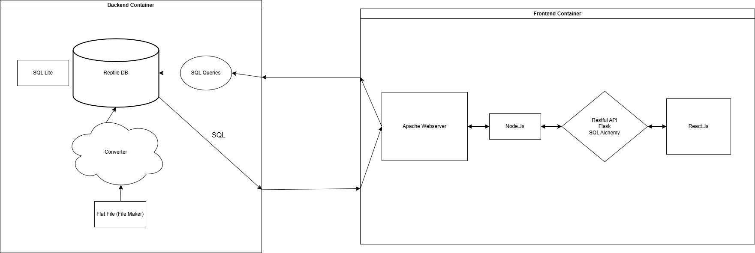


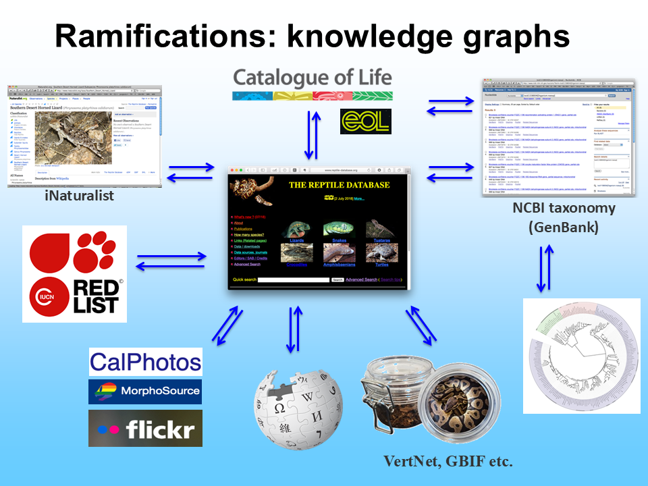



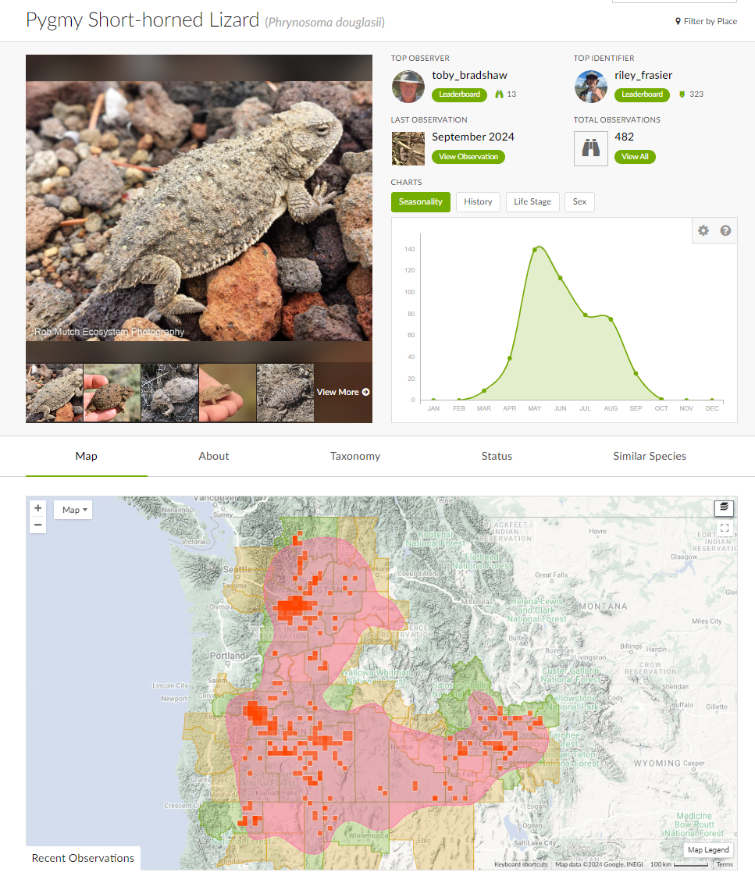
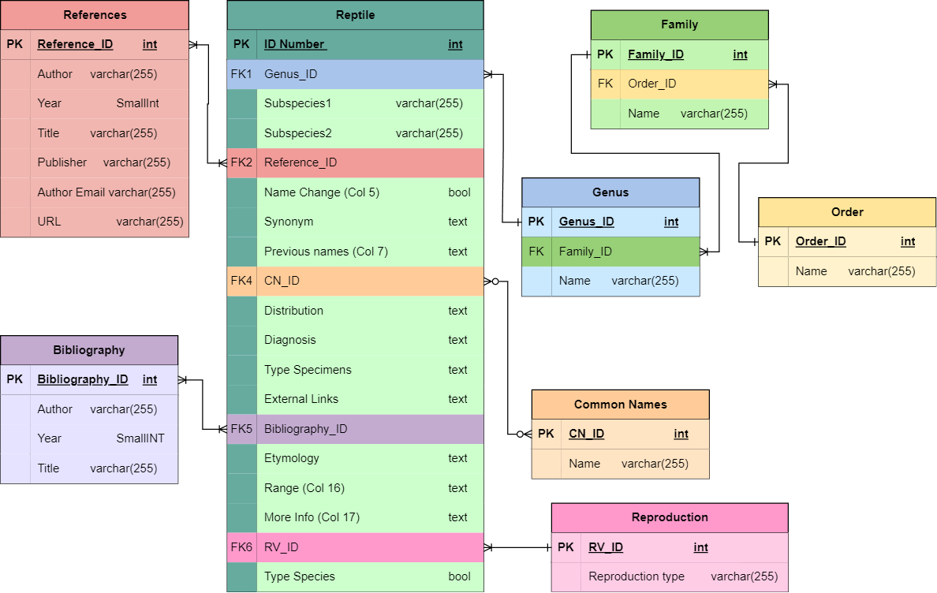
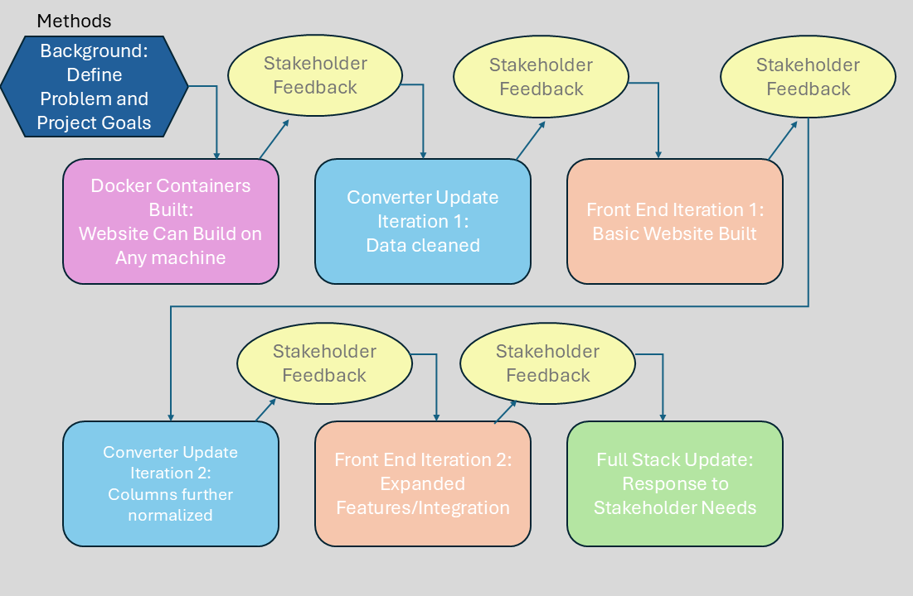
25-305
Reptile Database
Team members: Joshua Grove, Nathaniel Grove, Sanie Fragata, Elyse O’Rahilly | Faculty advisor: John Leonard, Ph.D. | Sponsor: Peter Uetz, Ph.D. | Mentor: Joao Soares, Ph.D.
Problem:
Current iteration of Reptile Database converter lacks some functionality. Ideally, the converter will produce a well normalized database that allows for searchability. The current front end will need to be reworked from the ground up in order to allow for integration with sites like iNaturalist.
Solutions:
Design next iteration of the Database Converter to further normalize the information presented
Optimize searchability of database and provide options for downloading specific entries
Integrate images and range information from sites like iNaturalist
Redesign front end to make a more user-friendly interface and allow for future integration of other services
Background: Dr. Peter Uetz has been hand-maintaining the only complete database of taxonomy for all known reptile species on earth. With over twelve thousand species, this information needs to be organized in a format that allows for use by biologists all over the world.
iNaturalist. (n.d.). Pygmy short-horned lizard (phrynosoma douglasii). https://www.inaturalist.org/taxa/36316-Phrynosoma-douglasii

